Slide 1
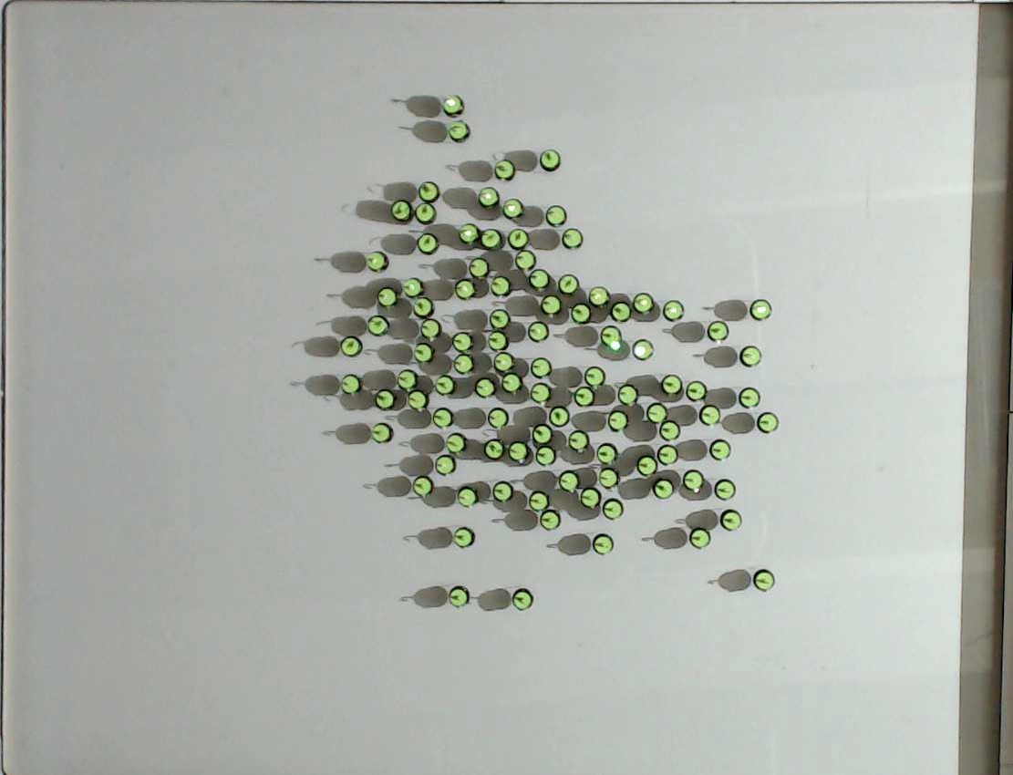
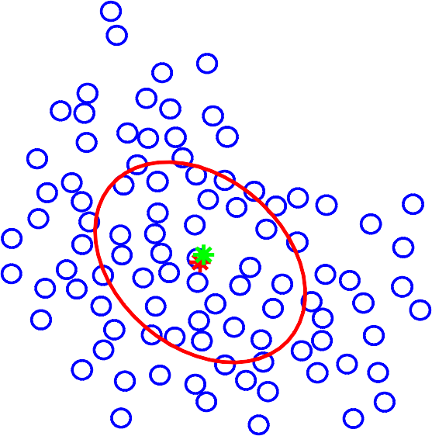
122.8
mean position (cm)
109.1
○
95.5
81.8
✪
68.2
0
100
200
300
400
500 600
700
time (s)
✪
○

